Slide 1


Gift of Life (GOL)
Committee Chair: Linnet Kwok
Rotary Year 2017-2018
January 16th 2018 Club Assembly

Slide 2
GOL Updates
GOL 2017-2018 Funds (in CNY)
 | Beg Bal as of July 1st | Activities | End Bal as of Dec 31st
GOL Funds in Shanghai Children Foundation | 142,250 | 54,333 | 87,917
 | Fund Granted | Committed Funds | Uncommitted Funds
Global Grant 1636196 | 1,422,000 | 1,264,357 | 157,643
Approved 32 surgeries since July 1st
Exploring potential partnership with The Chinese People’s Association for Friendship with Foreign Countries (CPFFC) 中国人民对外友好协会
Notes:
32 Cases in Rotary Year 2017-2018, 30 from GG

Slide 3
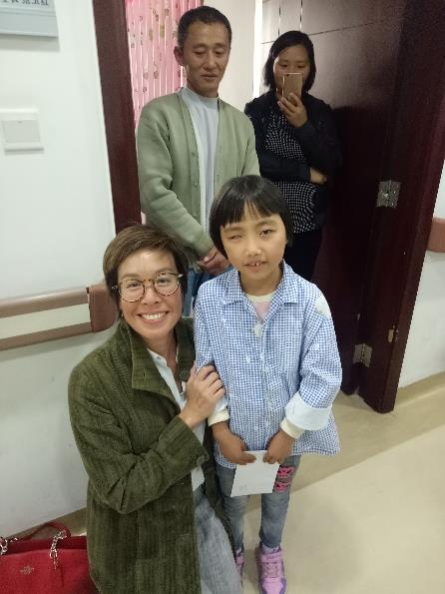
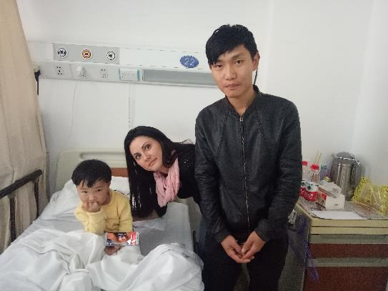
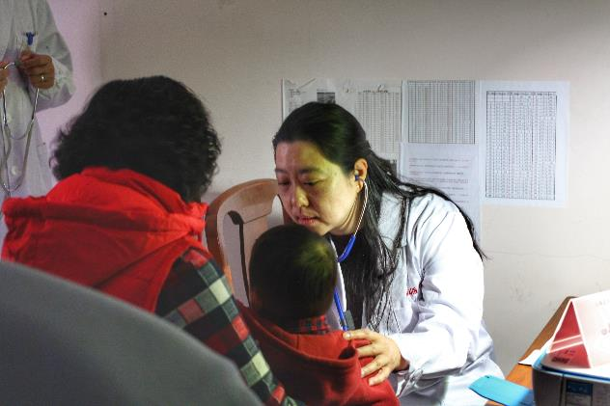
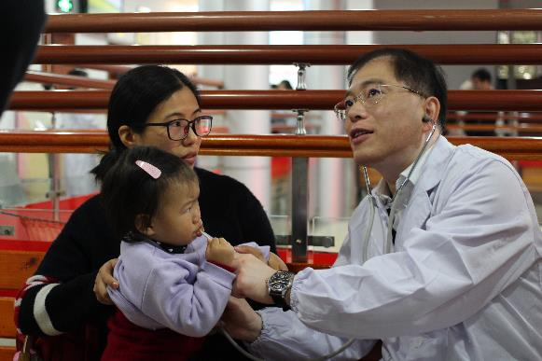
Activities
Patient Visits at Shanghai Chest Hospital (Nov 2017)
Shadowing Fudan Children Hospital for screening in Kunshan (Nov 2017)

