Slide 1


Gift of Life (GOL)
Committee Chair: Linnet Kwok
Rotary Year 2017-2018
September 26th 2017 Club Assembly

Slide 2
GOL Updates
GOL 2017-2018 Funds (in CNY)
 | Beg Bal as of July 1st | Activities | End Bal as of Aug 31st
RCS GOL Funds | 152,499 | 50,000 | 102,499
 | Fund Granted | Committed Funds | Uncommitted Funds
Global Grant 1636196 | 1,422,000 | 517,700 | 904,300
Approved 17 surgeries since July 1st
New committee member – Raluca Lapuste
China government tighten control in transfer of funds
Notes:
Cases in Rotary Year 2017-2018, 15 from GG

Slide 3
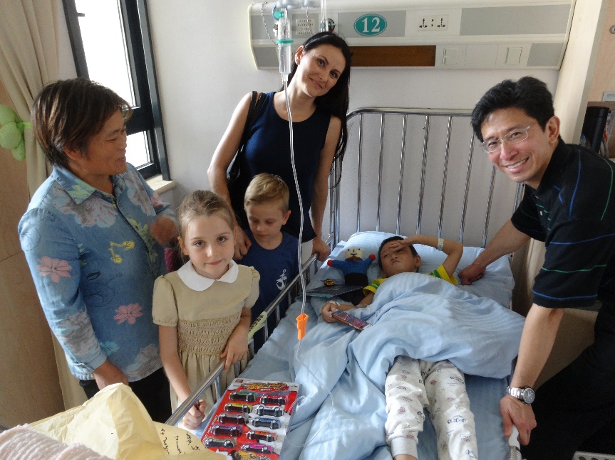
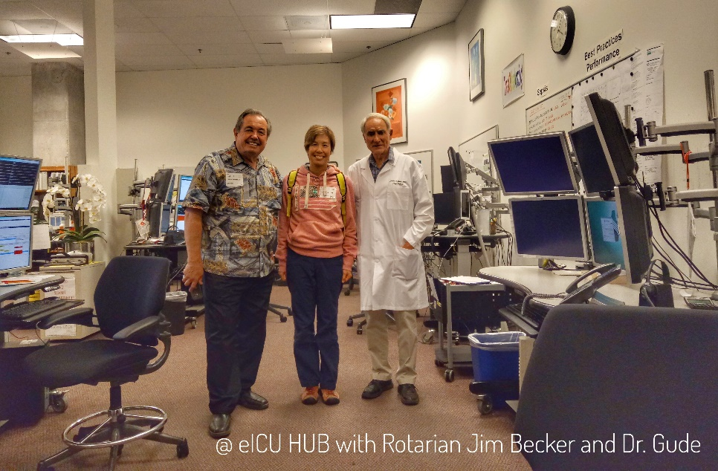
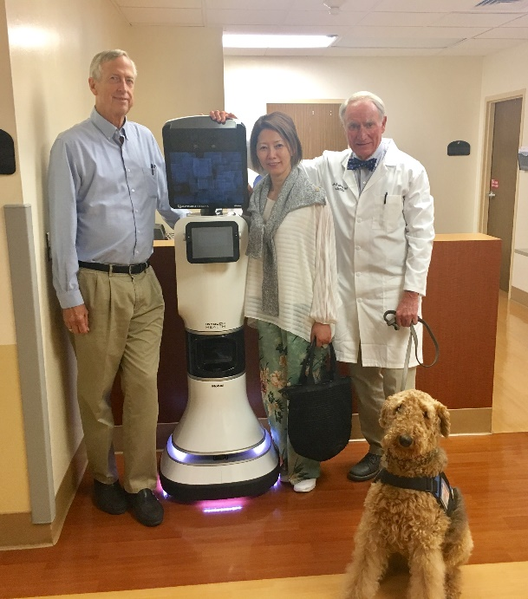
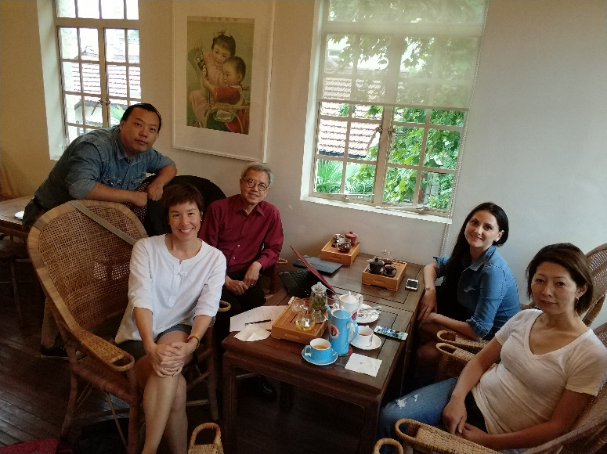
Activities
Patient Visits at Fudan Children Hospital
eICU visits, attending Grand Rounds in the US
Committee gathering

